Slide 1

INSERTION AND SELECTION SORT
Madhumitha . s
19pw13

Slide 2
selecTION SORT
Code snippet
Time complexity
examples

Slide 3
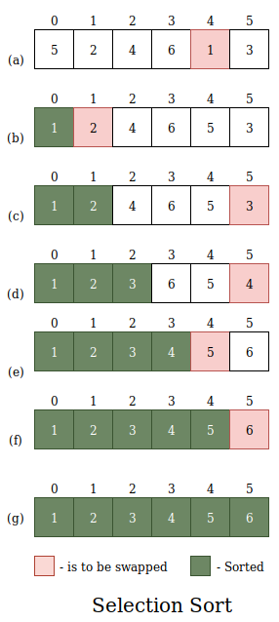
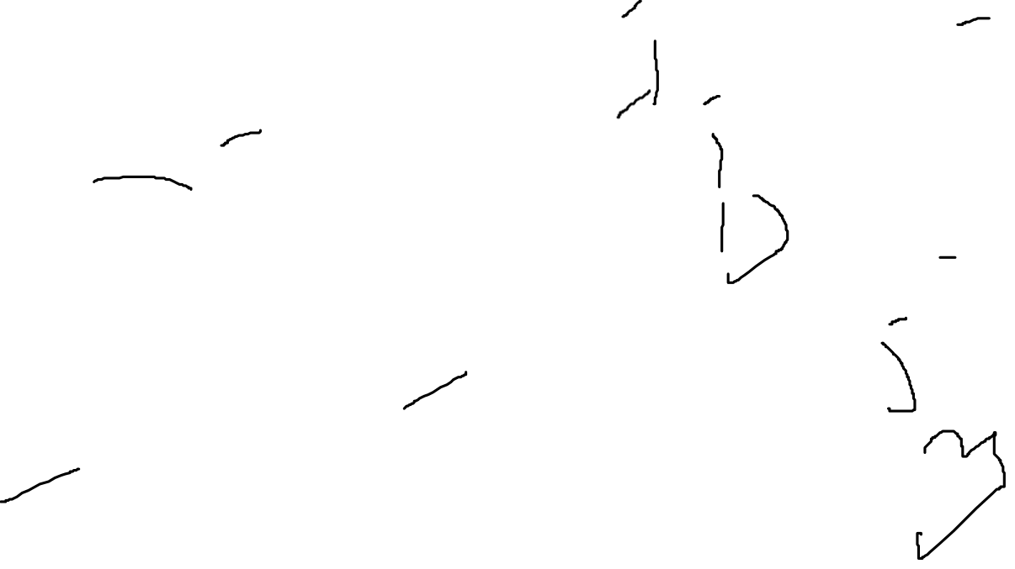
SELECTION SORT
The selection sort algorithm sorts an array by repeatedly finding the minimum element from unsorted part and putting it at the beginning. The algorithm maintains two subarrays in a given array
The subarray which is already sorted
Remaining subarray which is unsorted

Slide 4
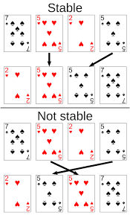
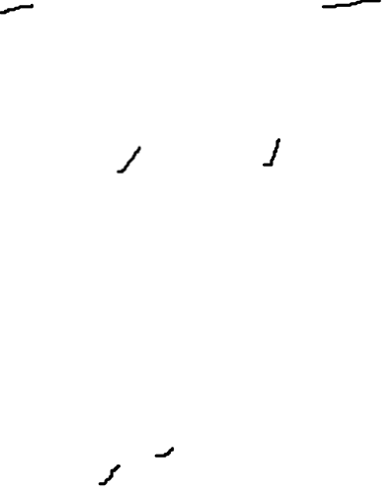
STABILITY in SORTing algorithms
A sorting algorithm is said to be stable if two objects with equal or same keys appear in the same order in sorted output as they appear in the input array to be sorted.
Selection sort can be made Stable if instead of swapping, the minimum element is placed in its position without swapping i.e. by placing the number in its position by pushing every element one step forward.

Slide 5
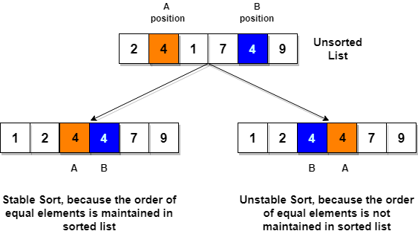


Slide 6
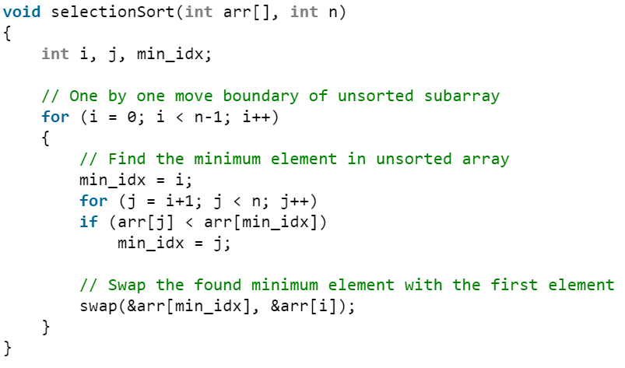
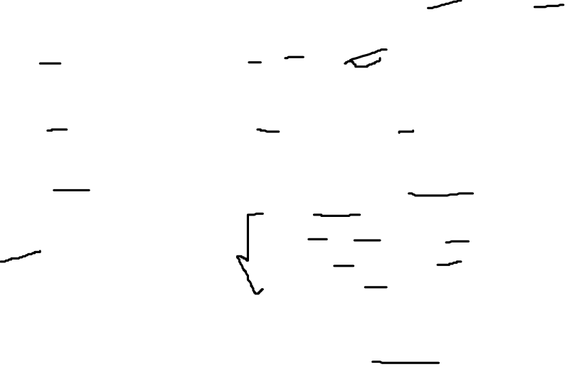
TIME COMPLEXITY FOR SELECTION SORT
Best case : O(n²)
Worst case : O(n²)
Average case : O(n²)
Space complexity : 1

Slide 7
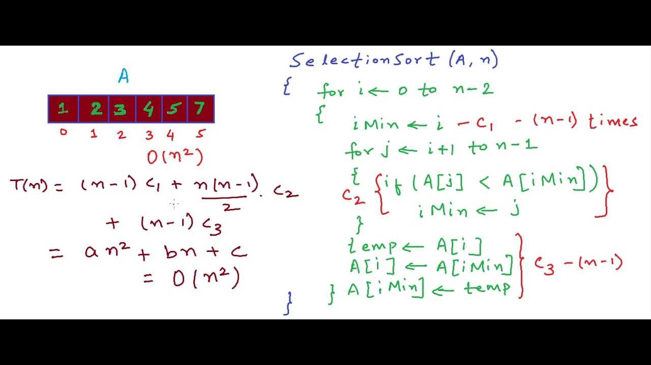
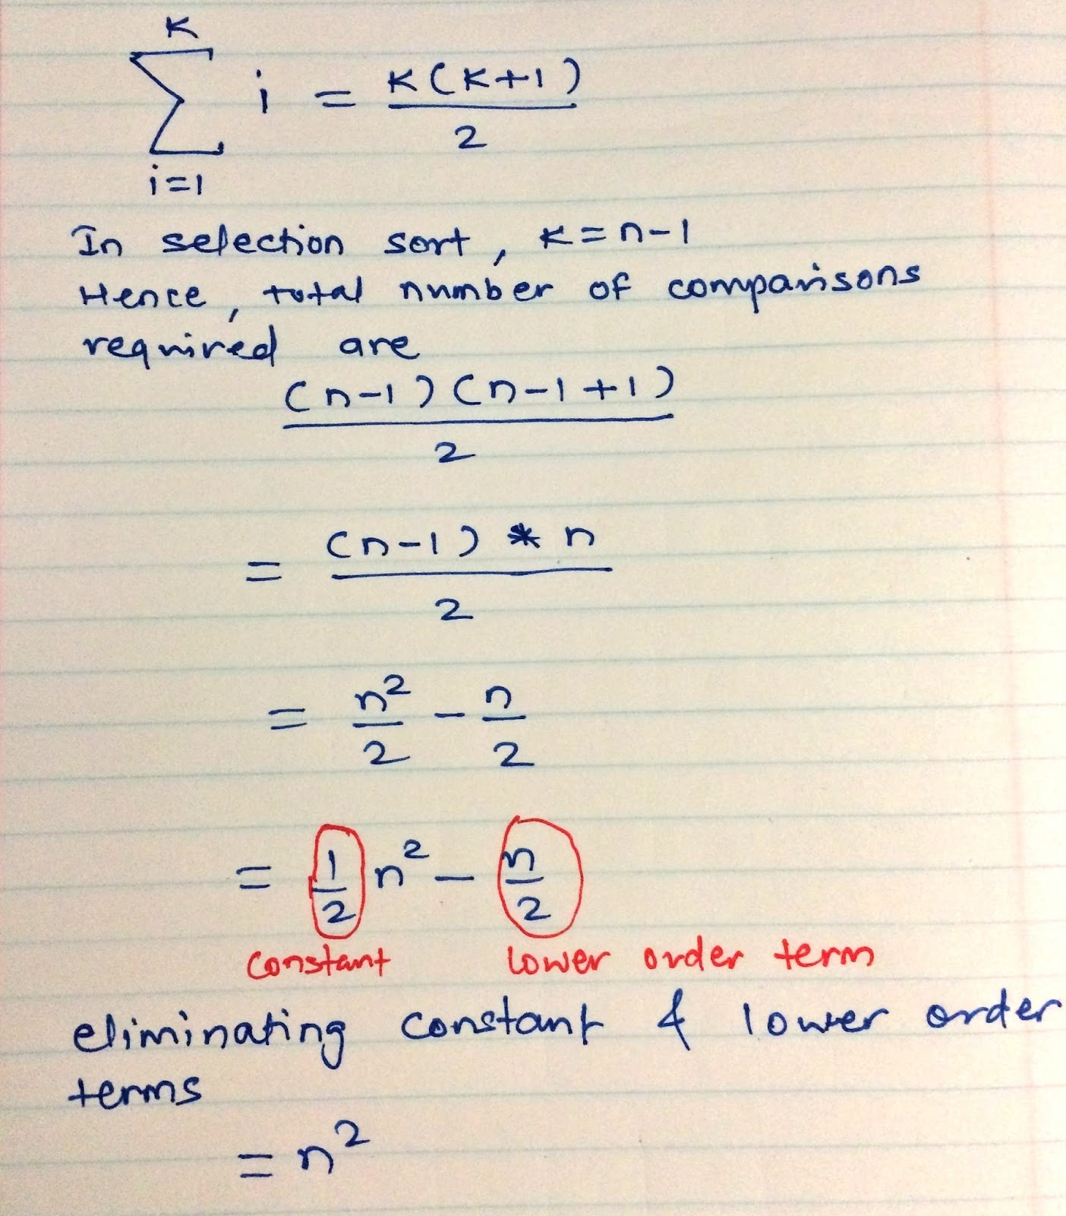
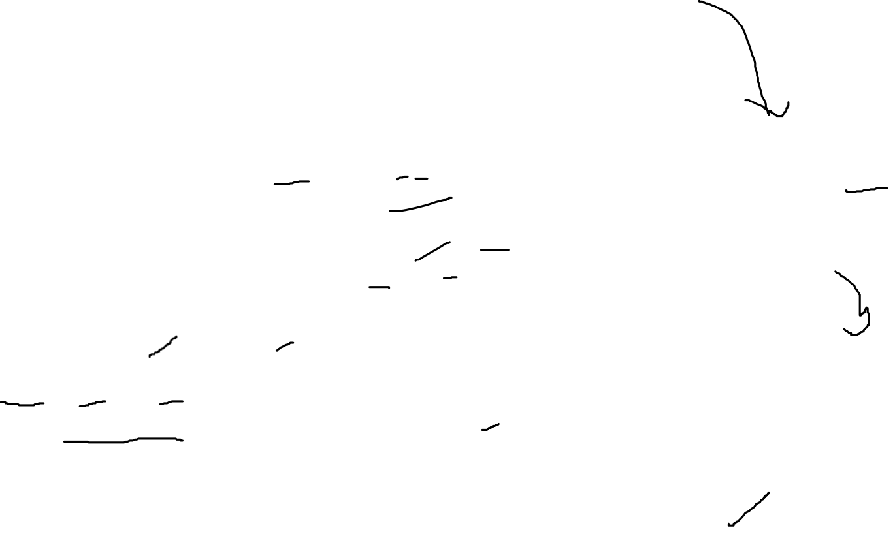
ANALYSING TIME COMPLEXITY

Slide 8
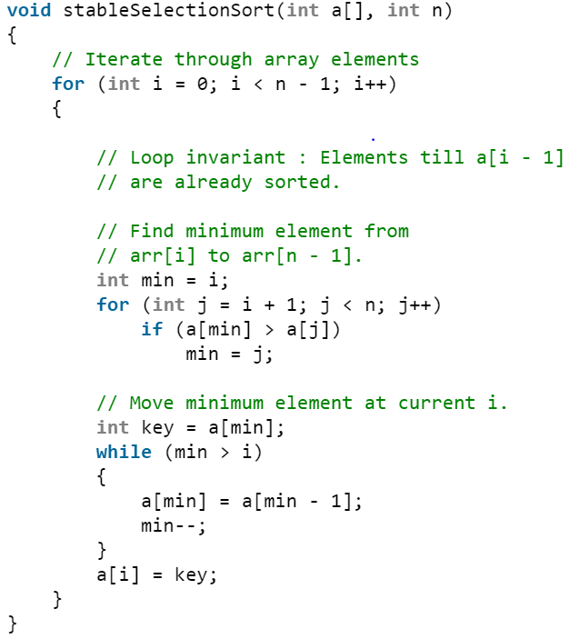
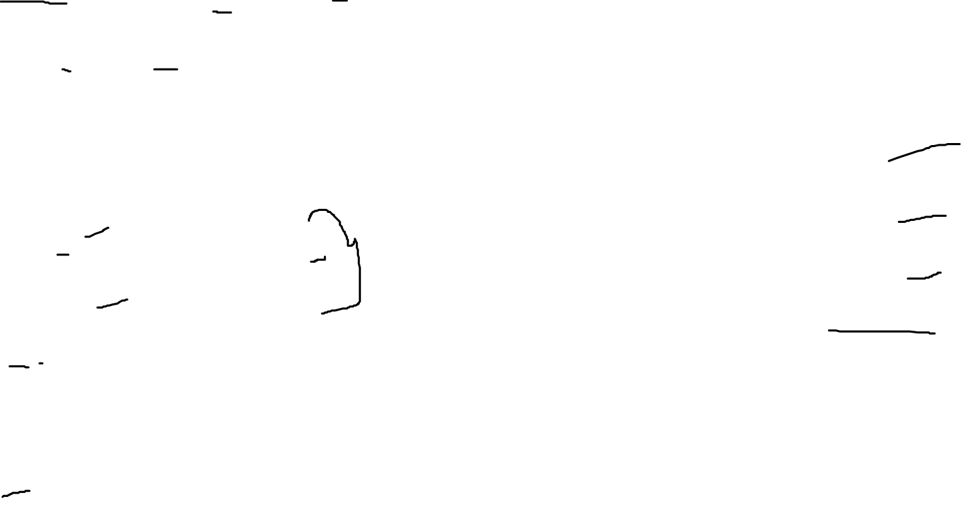
TIME COMPLEXITY FOR STABLE SELECTION SORT
Best case : O(n²)
Worst case : O(n²)
Average case : O(n²)
Space complexity : 1

Slide 9
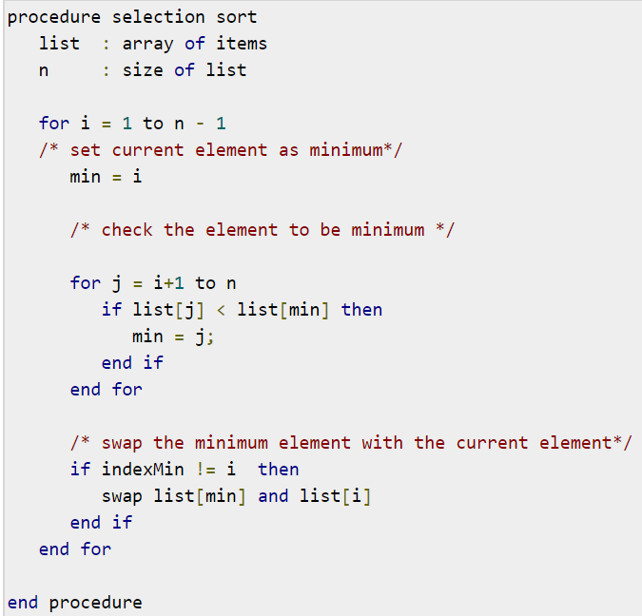
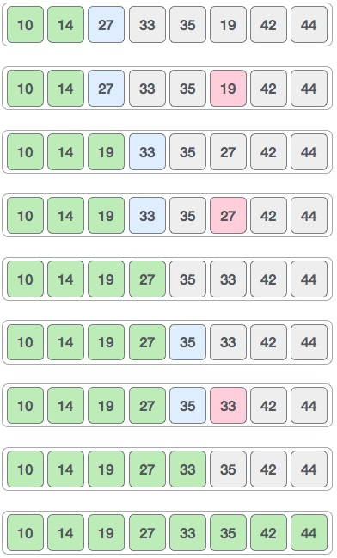
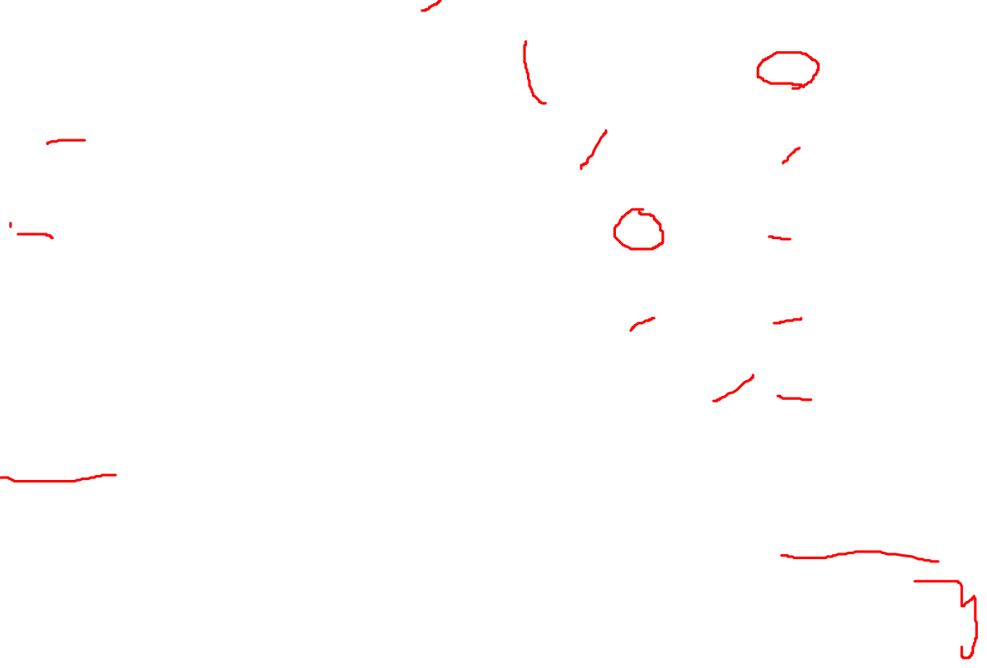
EXAMPLE OF SELECTION SORT

Slide 10
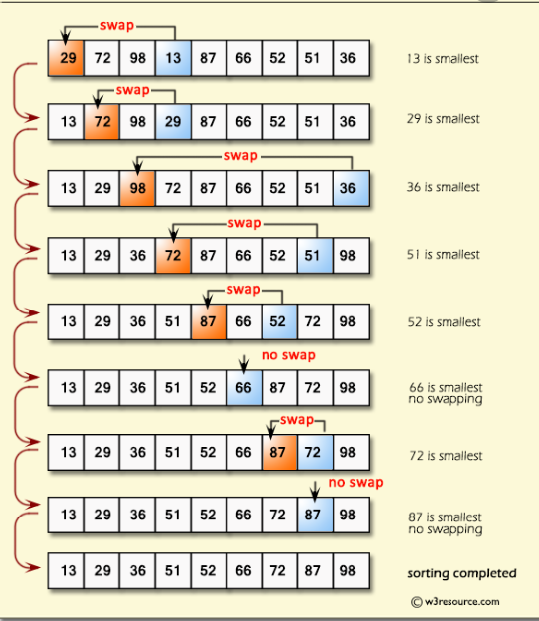


Slide 11
INSERTION SORT
Code snippet
Time complexity
examples

Slide 12
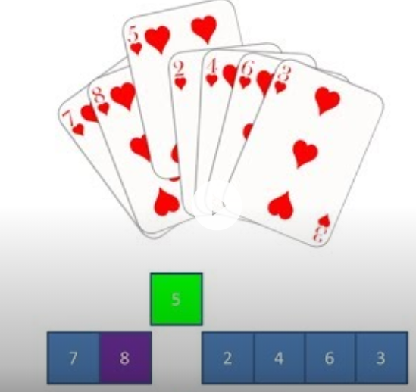
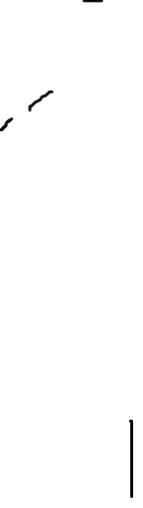
inserTION SORT
This is an in-place comparison-based sorting algorithm. Here, a sub-list is maintained which is always sorted.An element which is to be inserted in this sorted sub-list, has to find its appropriate place and then it has to be inserted there. Hence the name, insertion sort.

Slide 13
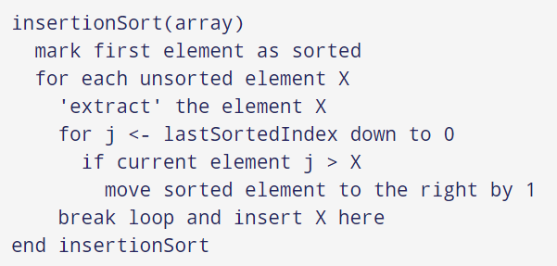
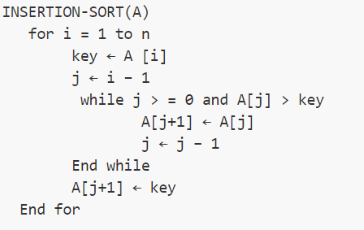
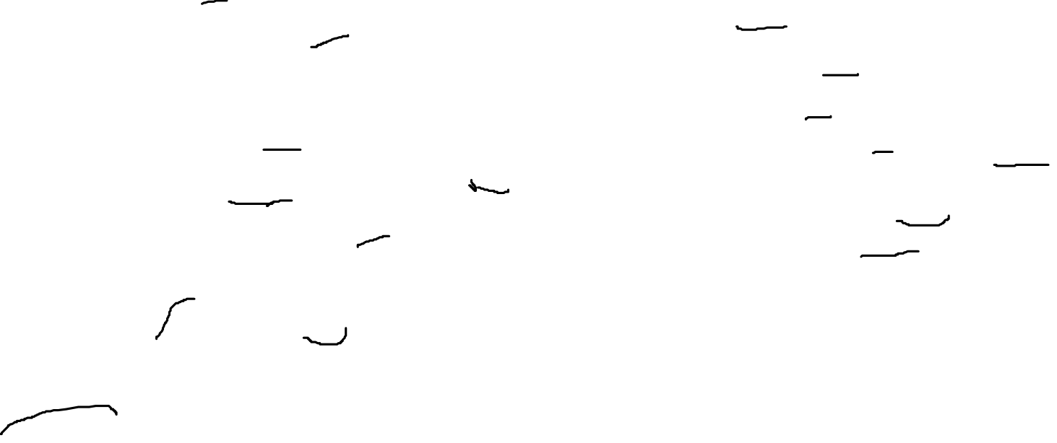
ALGORITHM and pseudocode

Slide 14
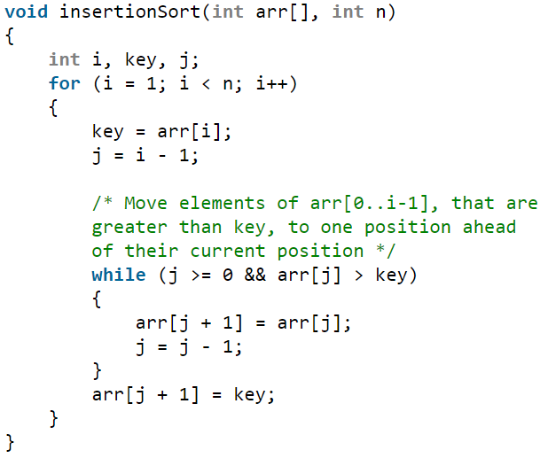
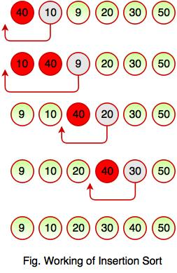
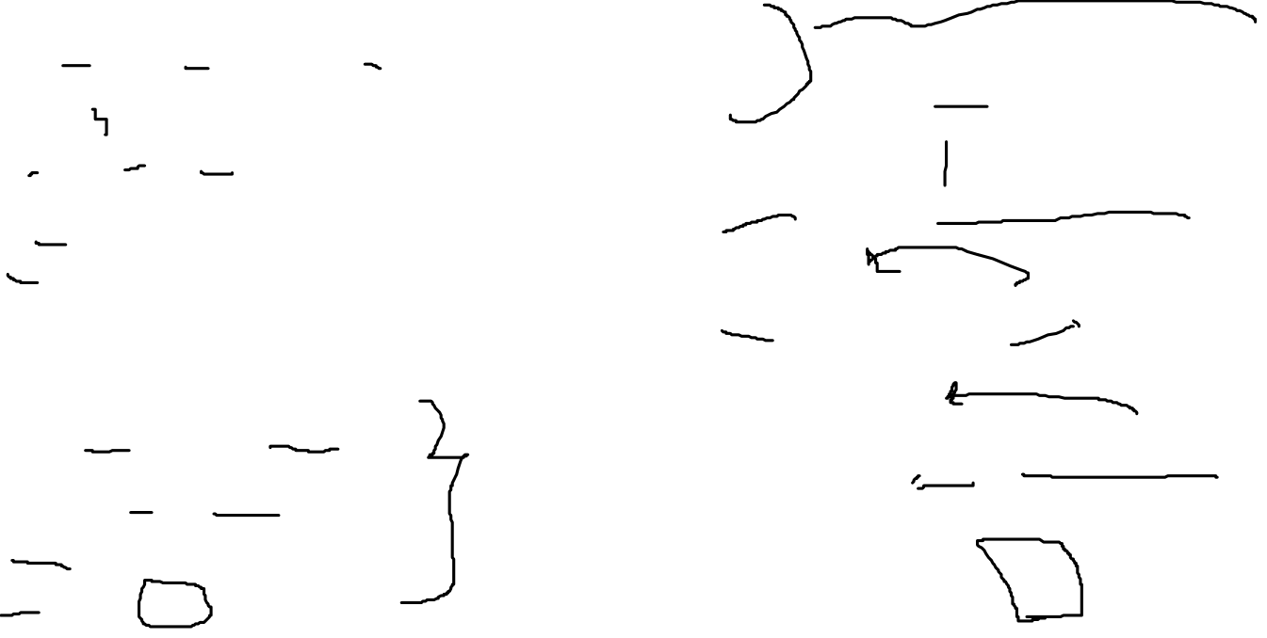
Code snippet and example

Slide 15
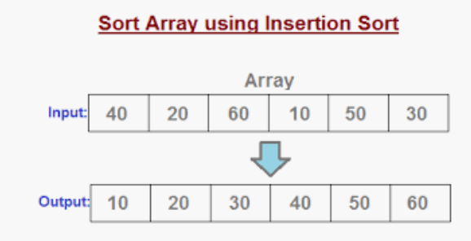
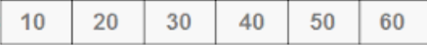
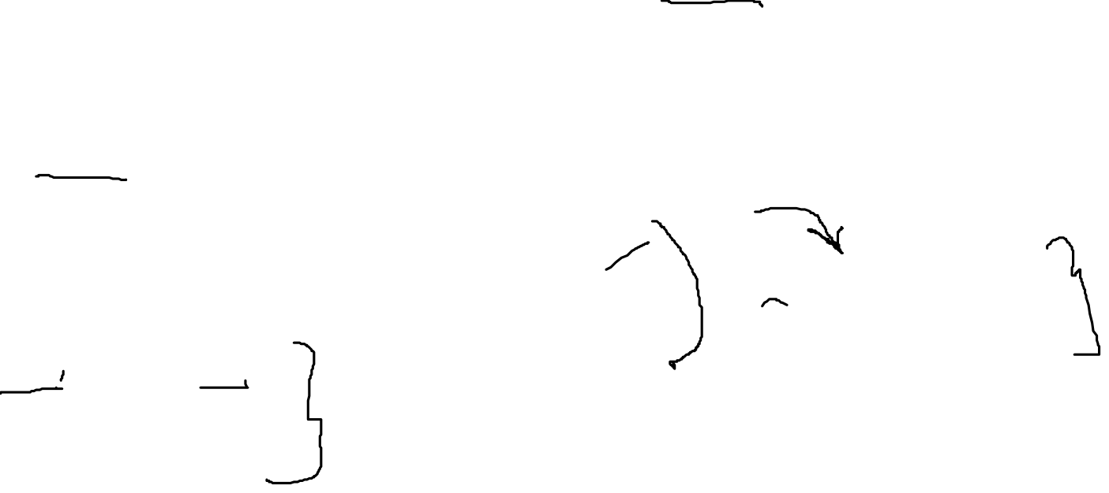
TIME COMPLEXITY
BEST CASE (sorted array as input) = O(n)

Slide 16
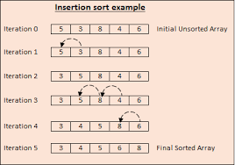
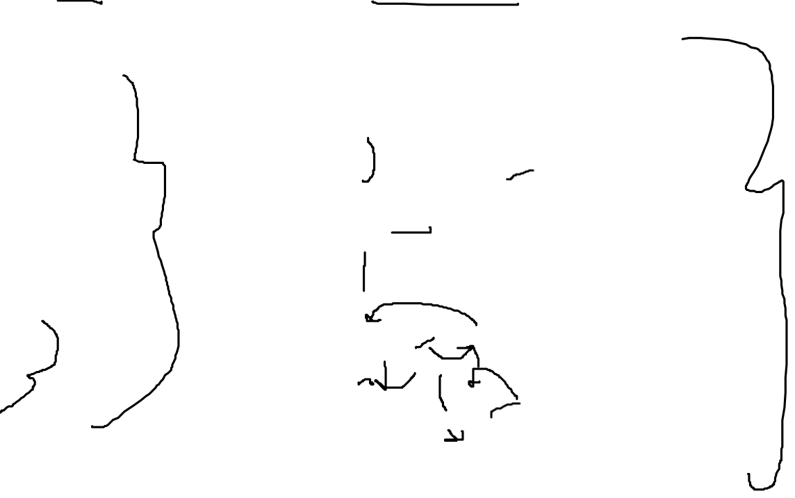
Worst case ( n traversions ) = O(n²)

Slide 17
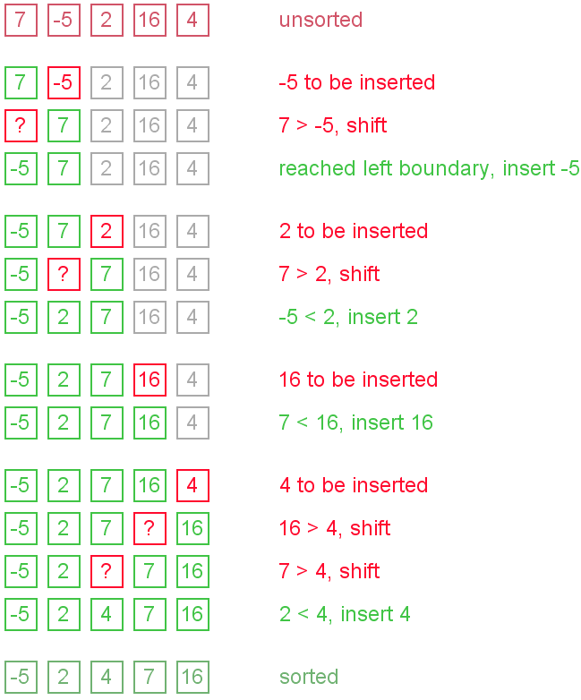
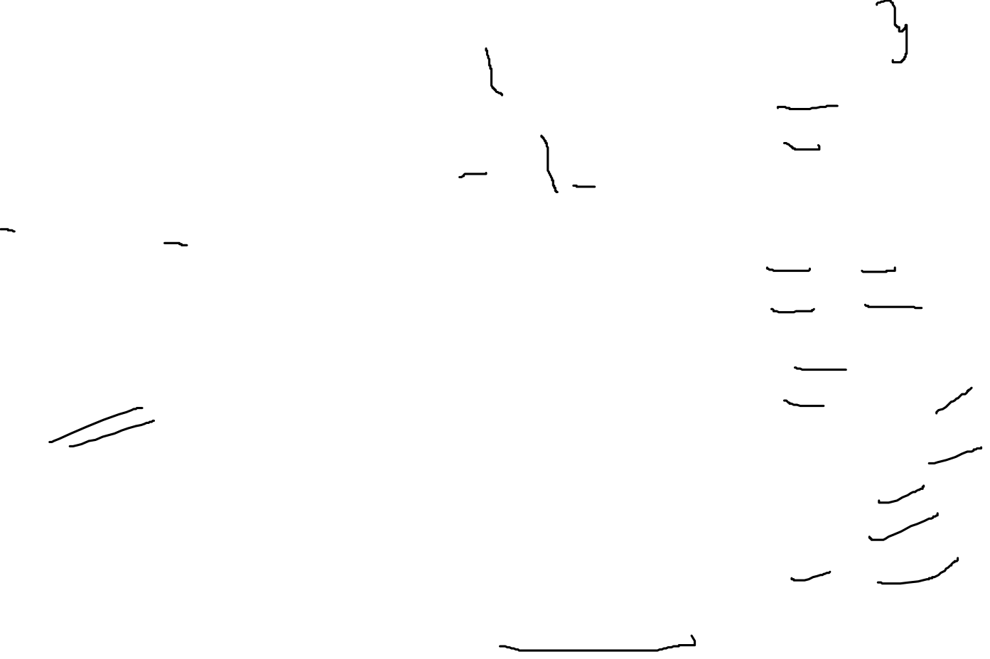
Average case :
(best case + worst case) / 2
= O(n) + O(n²)
2
= O(n²)

Slide 18
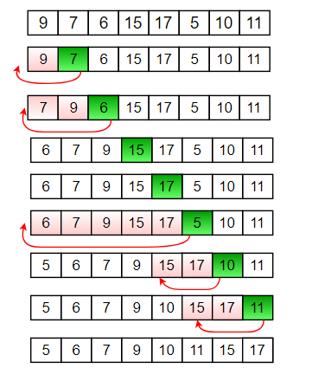
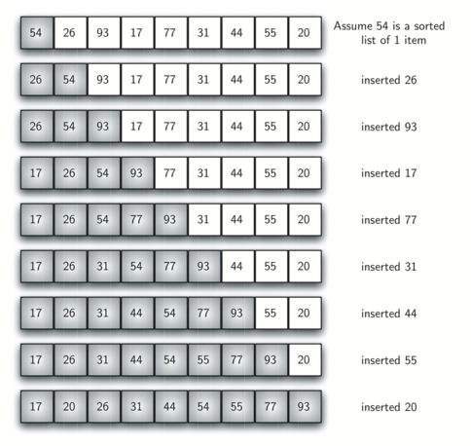
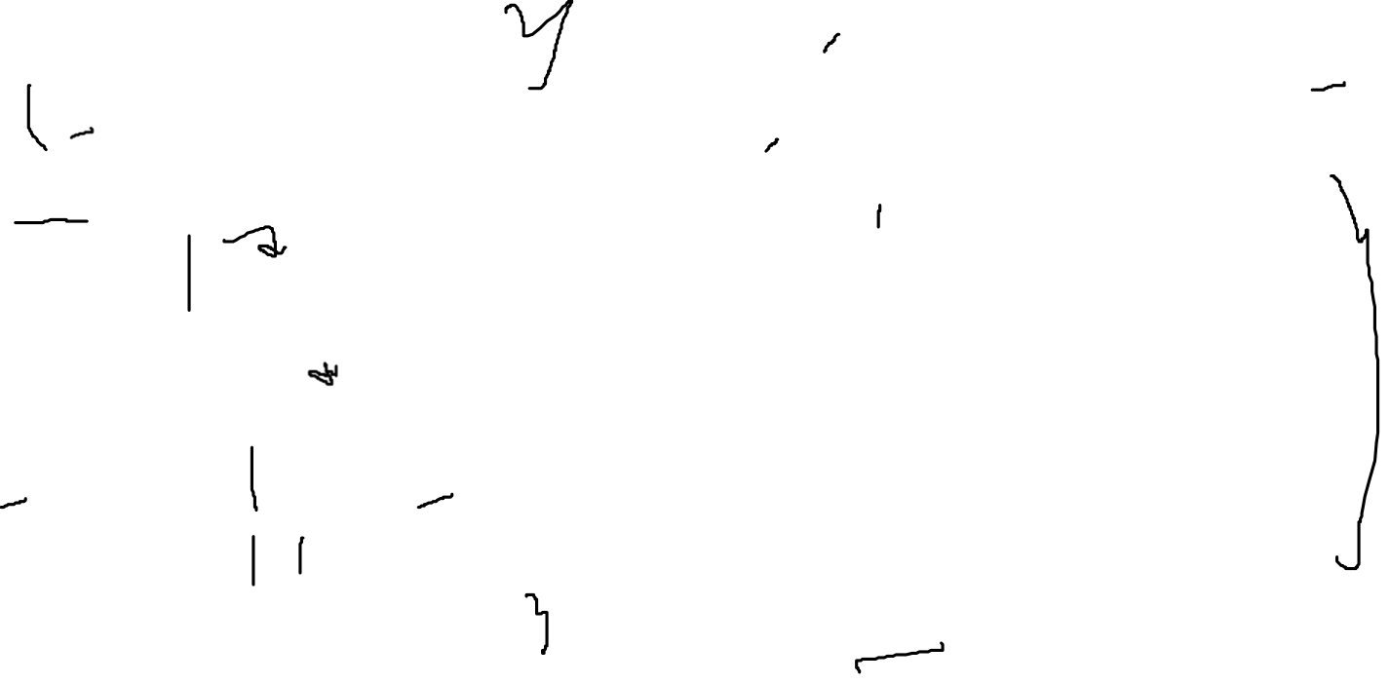
EXAMPLES

Slide 19
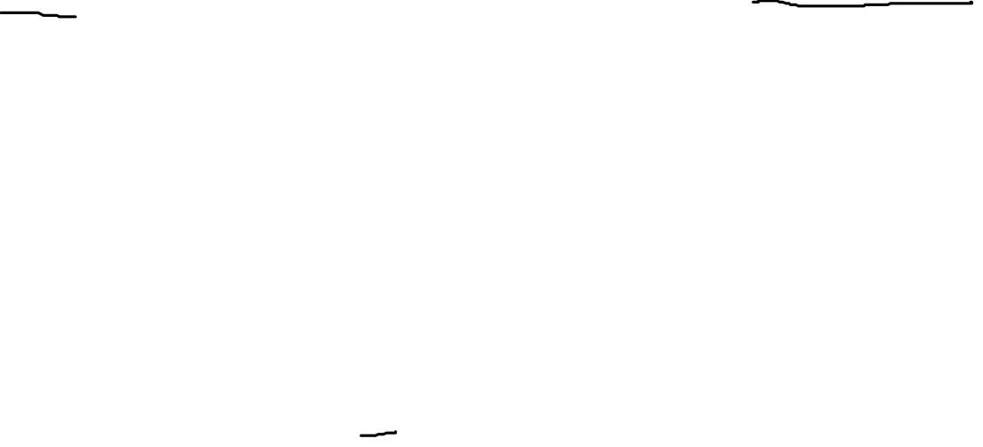
ADVANTAGES and disadvantages
SELECTION SORT :
The main advantage of the selection sort is that it performs well on a small list. Furthermore, because it is an in-place sorting algorithm, no additional temporary storage is required beyond what is needed to hold the original list.
The primary disadvantage of the selection sort is its poor efficiency when dealing with a huge list of items. The selection sort requires n-squared number of steps for sorting n elements. Additionally, its performance is easily influenced by the initial ordering of the items before the sorting process. Because of this, the selection sort is only suitable for a list of few elements that are in random order.

Slide 20
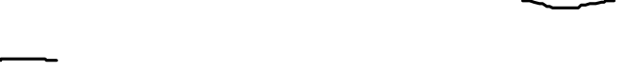
ADVANTAGES and disadvantages
INSERTION SORT :
The main advantage of the insertion sort is its simplicity. It also exhibits a good performance when dealing with a small list. The insertion sort is an in-place sorting algorithm so the space requirement is minimal.
The disadvantage of the insertion sort is that it does not perform as well as other, better sorting algorithms. With n-squared steps required for every n element to be sorted, the insertion sort does not deal well with a huge list. Therefore, the insertion sort is particularly useful only when sorting a list of few items.

Slide 21
THANKYOU

